Slide 1


Public Policy Navigation Using AI
An AI-driven approach to simplify public policy
under standing
Presented by:
Polipalli Rajesh

Slide 2

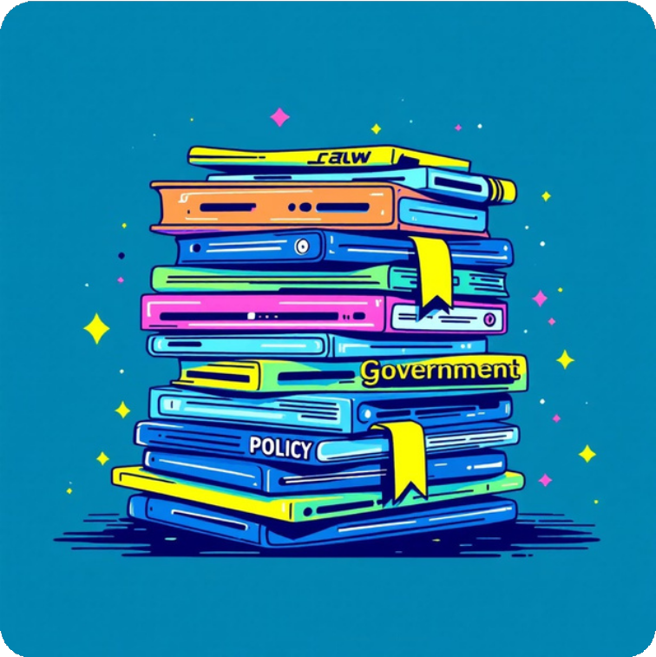
Introduction Of The Project :
Policy Navigation is an AI-powered platform designed to transform complex public policy documents into accessible, interactive, and user-friendly information. By leveraging advanced technologies like Optical Character Recognition (OCR) and Natural Language Processing (NLP), the system enables users to effortlessly search, summarize, and ask questions about lengthy policy documents.
We need an intelligent system that makes policies
readable, searchable, and truly interactive.

Slide 3




Project Vision & Solution
Bridge the Gap
Connectcomplexpolicy documents with public accessibility through intelligent technology
AI-Powered Platform
Leverage OCRand advanced NLP to extract, process, and understand policy content
Key Capabilities
Intelligent summarization Context-aware Q&A
User-friendly interface
Impact: Accelerate research timelines, empower informed citizens, and enable better decision-making across all levels of governance.

Slide 4





Milestone 1 :
BasicFileUpload&Chat Interface
Step 1: Streamlit App Setup
Created a clean Streamlit web application
Added a multi-format file uploader (TXT, CSV, Excel)
Step 2: File Processing
Implemented file type detection and content extraction
Added text preview showing the first 5 lines for user verification
Step 3: Basic Chat Interface
Integrated Streamlit chat input and display components
Added session state management for maintaining conversation history
Tools Used: Streamlit, Python

Slide 5







Milestone 2 :
OCRIntegration&JSON Export
Step 1: PDF Processing Setup
Integrated pdfplumber for text-based PDF extraction Added pytesseract OCR for scanned/image-based PDFs
Step 2: Document Processing
Implemented automatic PDF type detection (text vs. scanned)
Processed and converted document images to machine-readable text
Step 3: Data Export & Storage
Designed structured JSON format for extracted content
Implemented JSON export functionality with metadata preservation
Tools Used: pdfplumber, pytesseract, pdf2image, JSON

Slide 6


Milestone 3 :
Intelligent Q&A with Testing
Document Processing & Chunking
Implementedtextsegmentation
AI Model Integration
SetupOllamawith the Ollama 3.1 model
Configured streaming and blocking response modes
Response System
Implementedcosine similarity for content retrieval
Added context-aware answer generation
into overlapping chunks
Tools : Ollama, Requests.

Slide 7

Technology Stack
Component
Frontend Backend
Document Processing NLP & AI
Data Handling Communication
Technologies
Streamlit
Python
pdfplumber, pytesseract, pdf2image
Ollama (Llama 3.1)
Pandas, JSON
Requests

Slide 8





Project Architecture
End-to-End Processing Pipeline
Input Layer ³ Accepts policy documents in PDF/Text formats
Pr epr oc e s sin g ³ Extracts and cleans text using
OCR
AI/NLP Layer
³ Generates summaries and answers questions With the Help of Ollama
Storage Layer
³ Saves processed data in JSON format
Output Layer
³ Displays results via user interface
The Architecture ensures seamless data flow from document upload through AI processing to intelligent response deliver y.

Slide 9

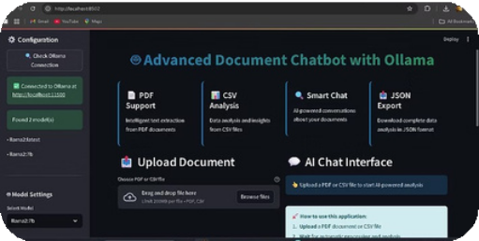
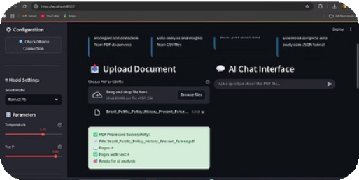
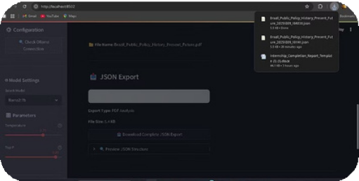
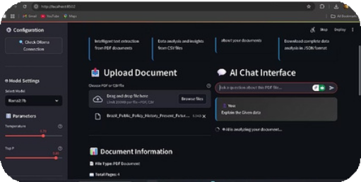
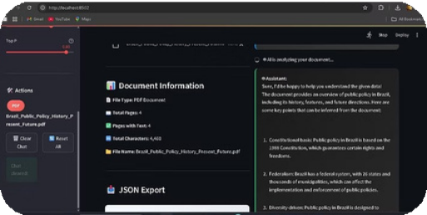
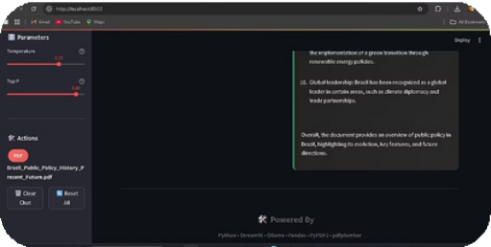
Output (Screenshots)
Interface demonstrations and real-world application
These screenshots demonstrate the platform's intuitive interface, from document upload through intelligent query processing to comprehensive answer generation.

Slide 10

Challenges Faced:
Challenge
Understanding AI in policy context Handling diverse document formats Virtual collaboration
Balancing academics with internship
Solution
Mentor guidance + self-learning
Dual extraction approach
Regular sync-ups and clear communication Structured time management

Slide 11







Performance Metrics & Impact
95%+ 70%
70%
OCR Accuracy
Precisetextextractionfromcomplex policy documents
Length Reduction
Time Saved
Effective summarization while preserving key information
Dramaticallyreducedresearchand analysis time
Outcomes
Accurate OCR Extraction 3 95%+ accuracy in converting scanned docs to text Effective Summarization 3 Long policies reduced by ~70% while keeping meaning Contextual Q&A 3 Instant, relevant answers to user queries
Time Efficiency 3 Reduced research/reading time by ~70%
User Engagement 3 Citizens, researchers, and policymakers can interact easily
Scalable Framework 3 Can be extended with Ollama or other LLMs for advanced Q&A

Slide 12





Conclusion & Vision
Ourjourney isabouttransforming how policies are created, understood, and engaged with. By harnessing the power of AI, we envision a future where governance is not just efficient, but also inherently interactive and accessible to all.
For Citizens
Easy access to complex policies, simplified explanations, and a clear understanding of rights and duties, fostering greater civic
par ticipation.
ForResearchers
Streamlined access to vast policy datasets, faster analysis, and deeper insights for crafting evidence-based recommendations and studies.
For Policymakers
Data-driven decision-making, efficient policy drafting, improved communication with constituents, and enhanced accountability.
This innovative approach paves the way for transparent, AI-driven governance, significantly boosting public participation, fostering accountability, and ultimately building stronger, more informed communities.

Slide 13


Thank you.
Together, wearetransforming governance through AI innovation, paving the way for a more engaged and informed society.
Explore Our Project
Visit GitHub Repository

